Slide 1

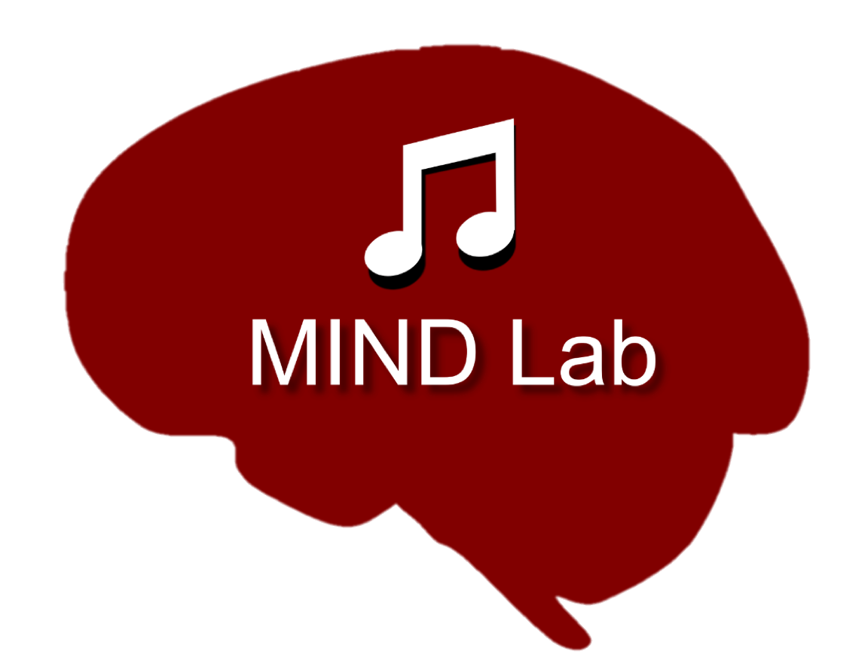
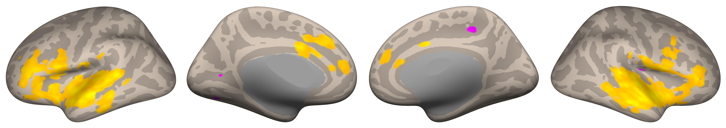
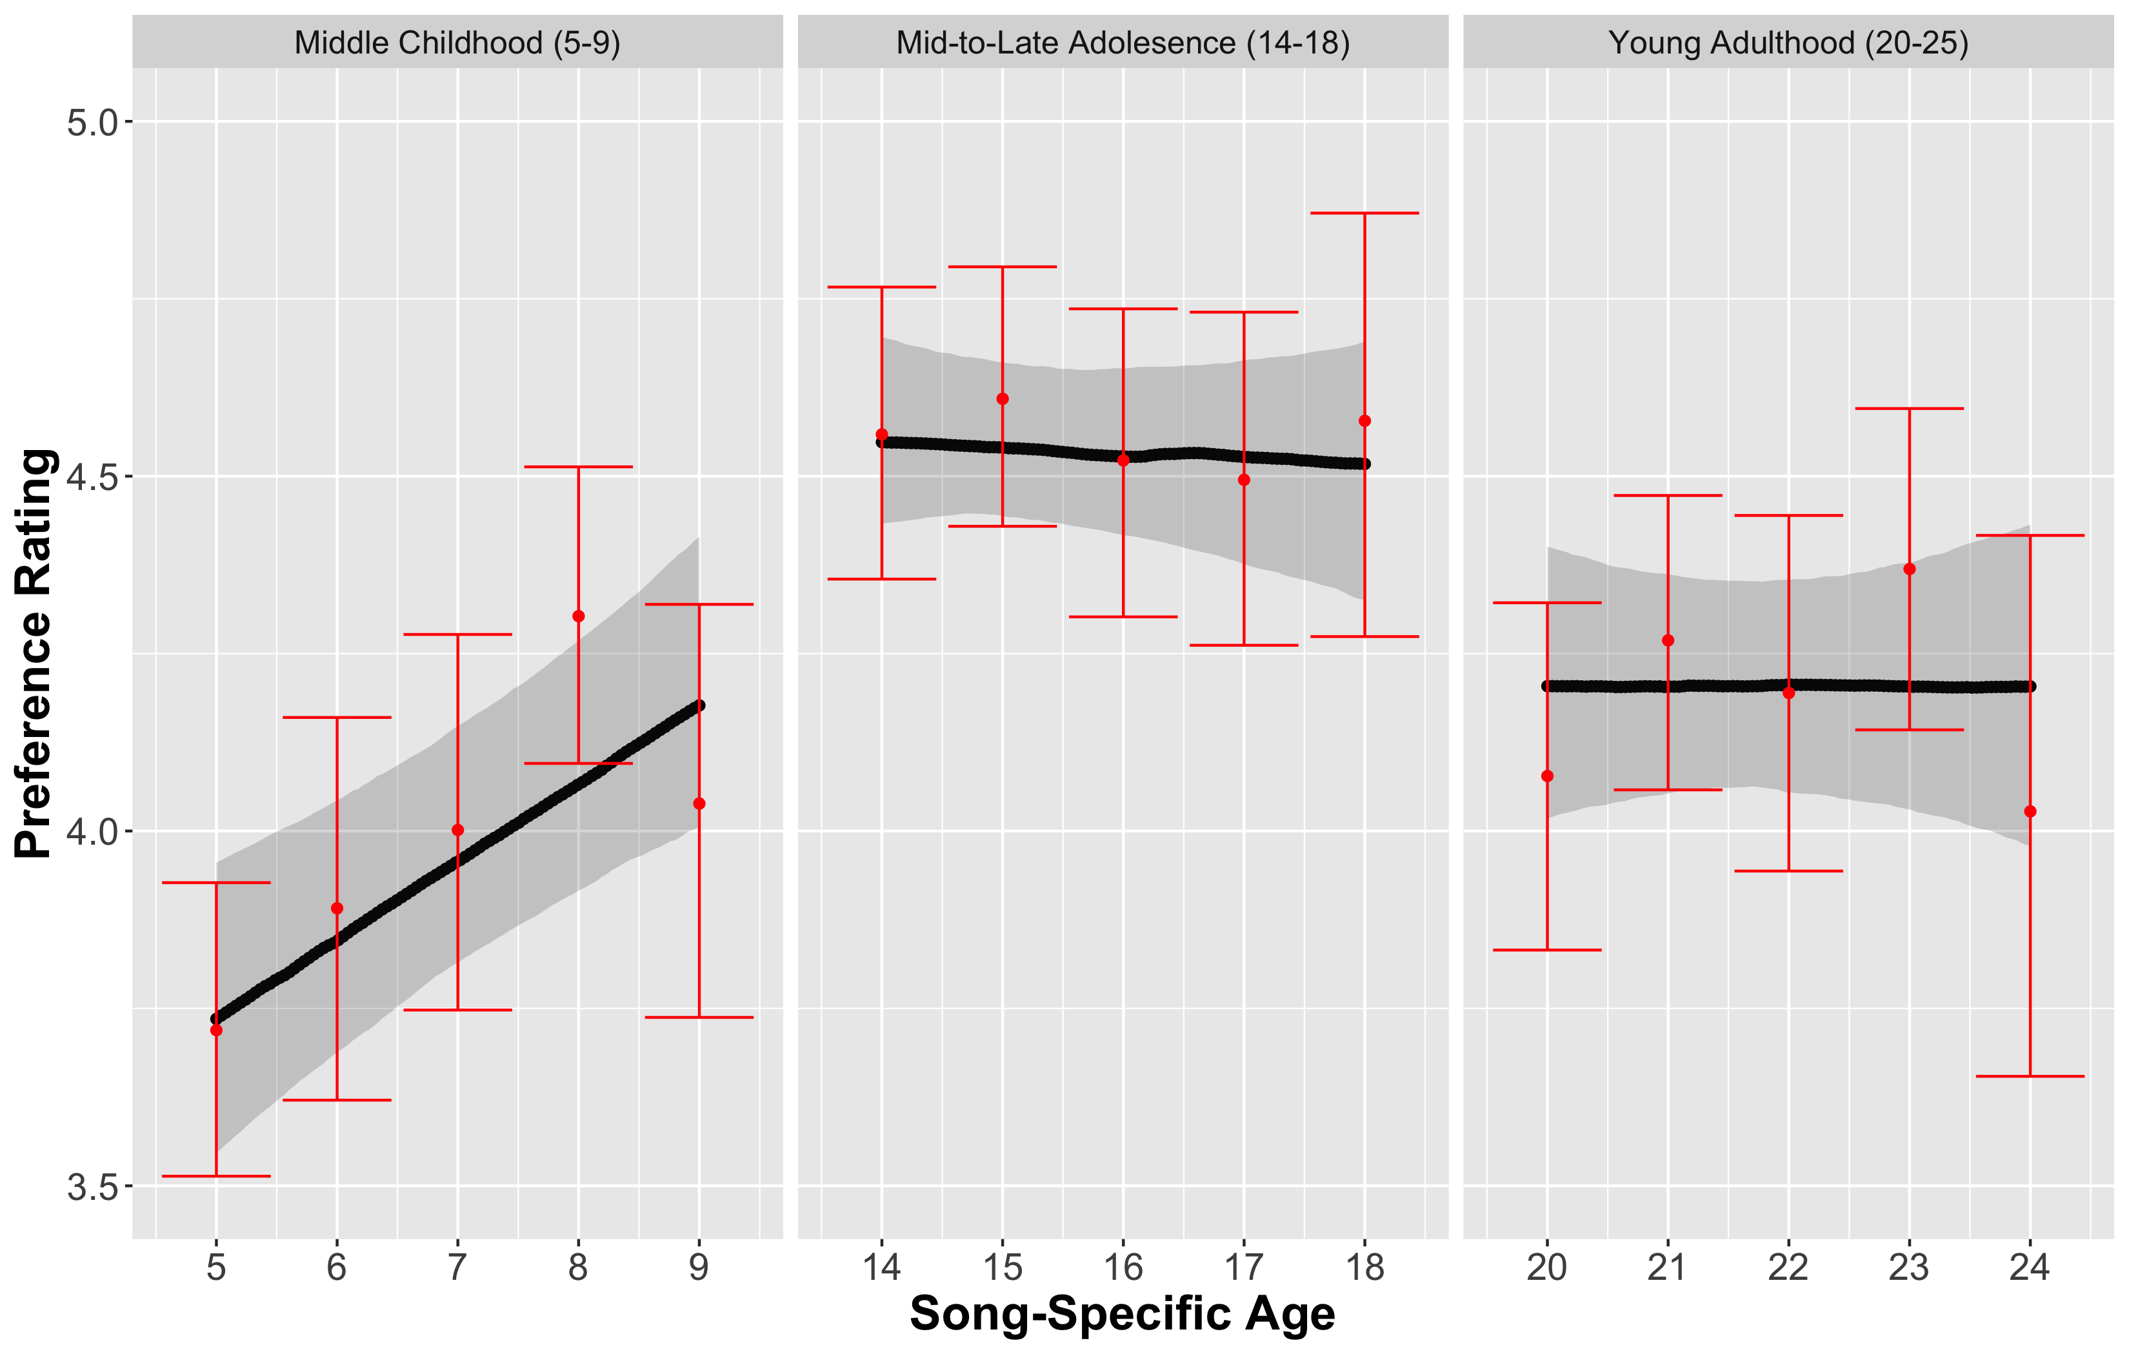
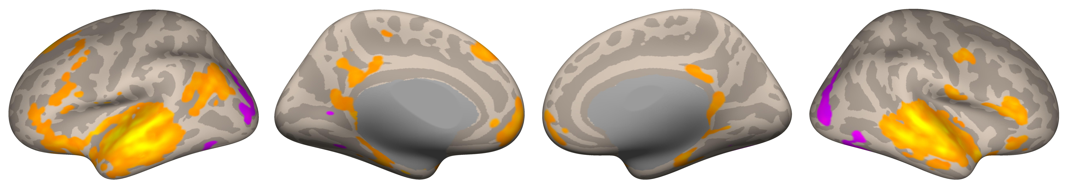
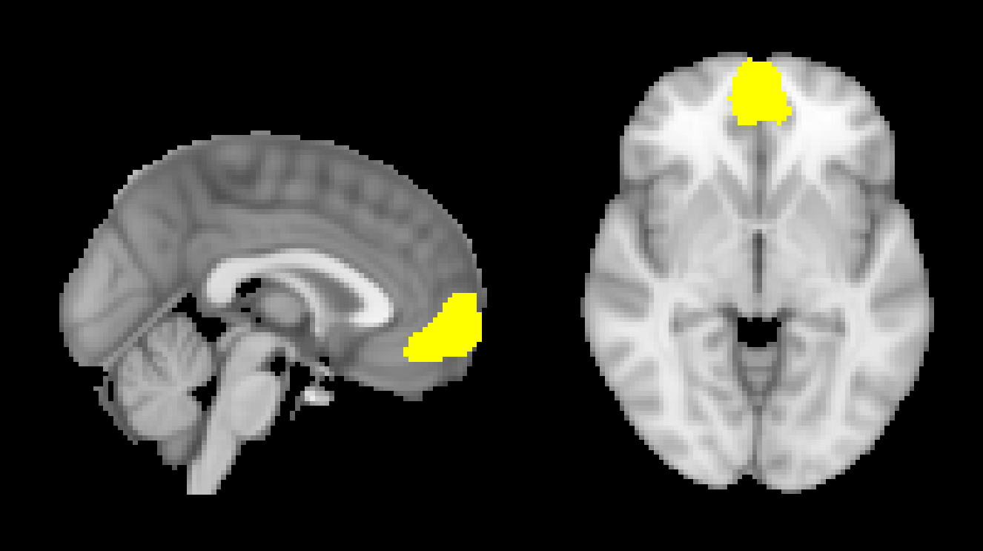
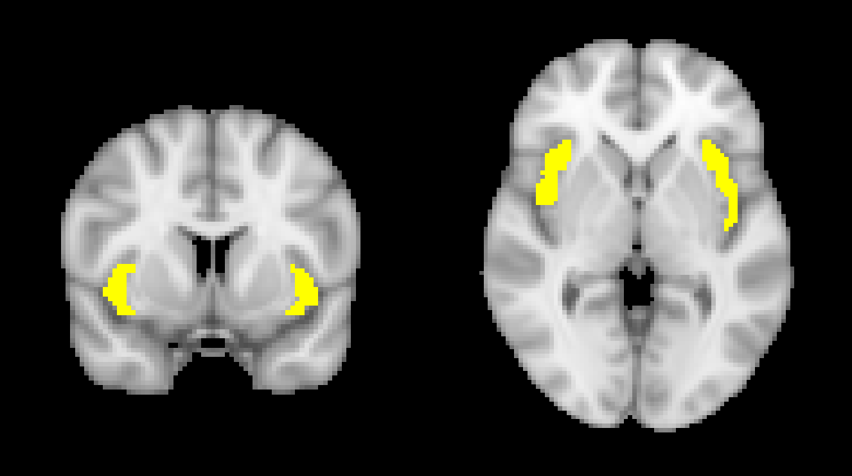
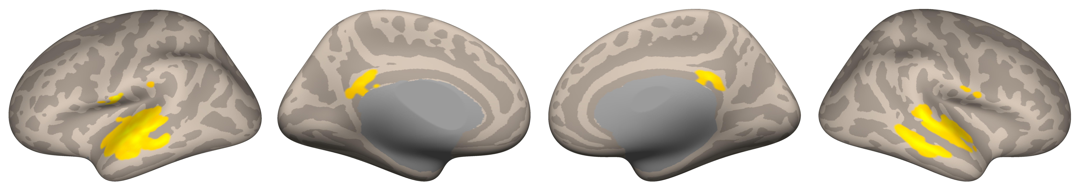
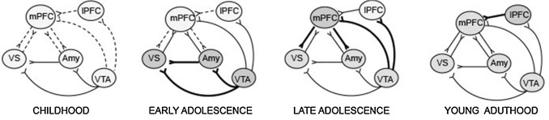
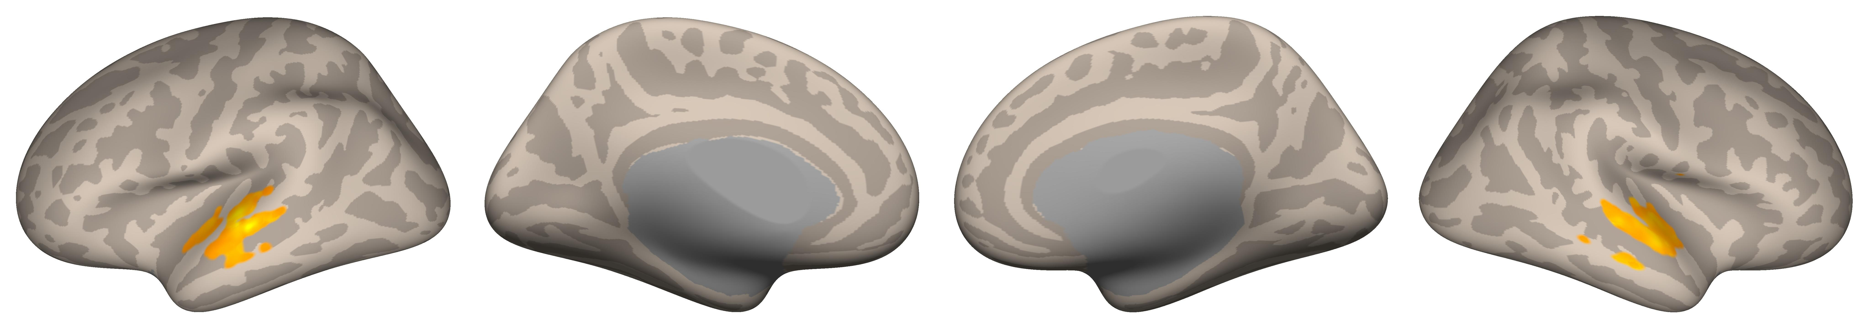
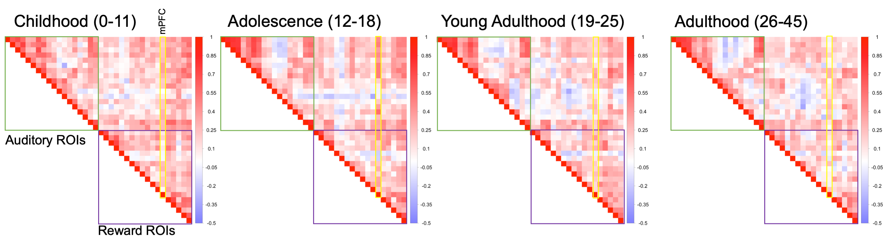
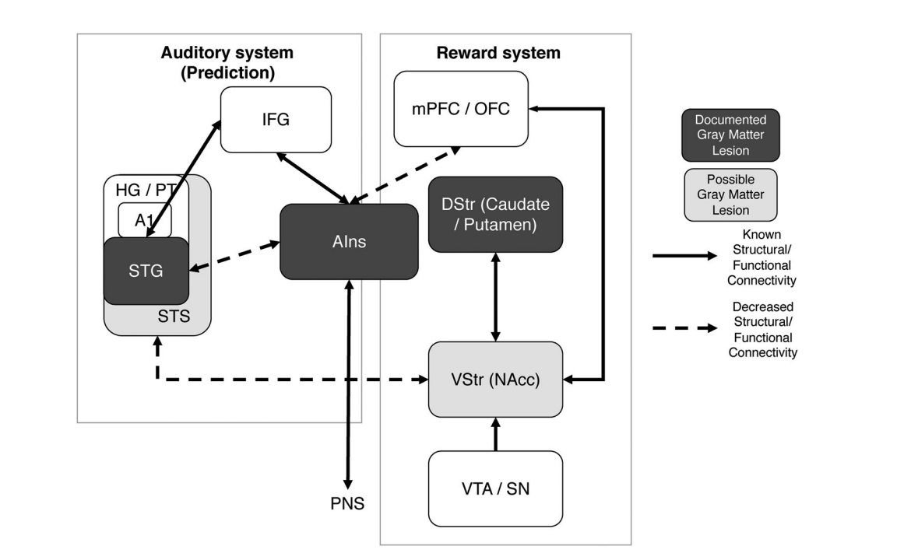
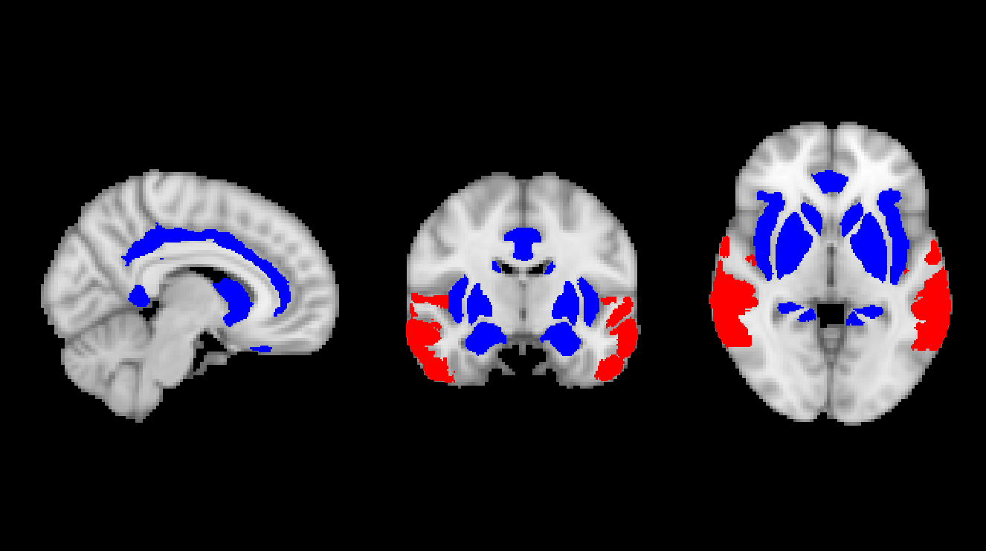
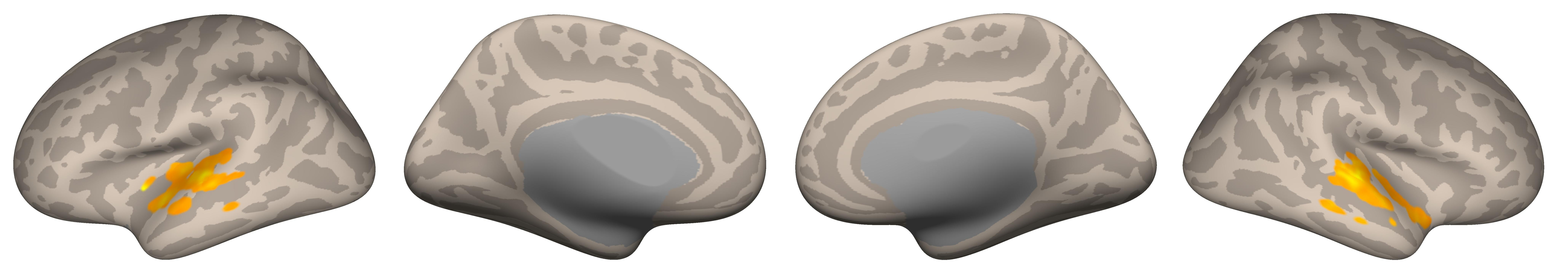
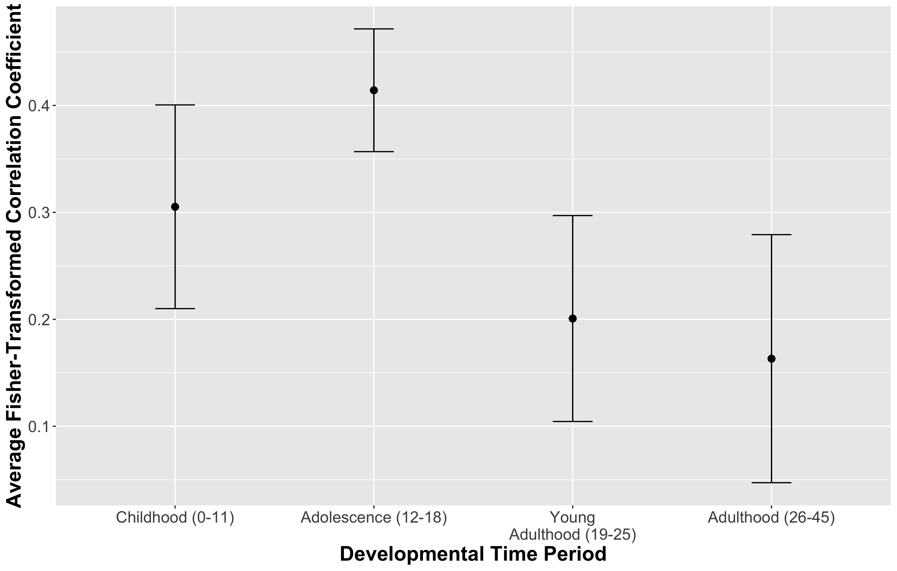

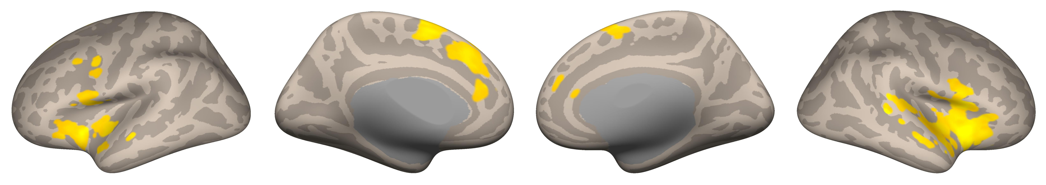

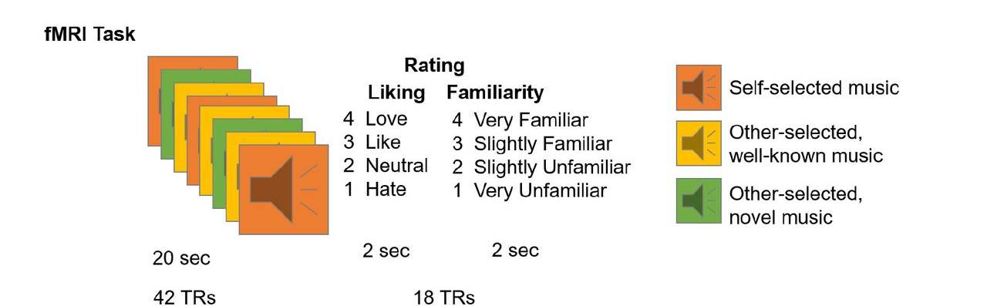
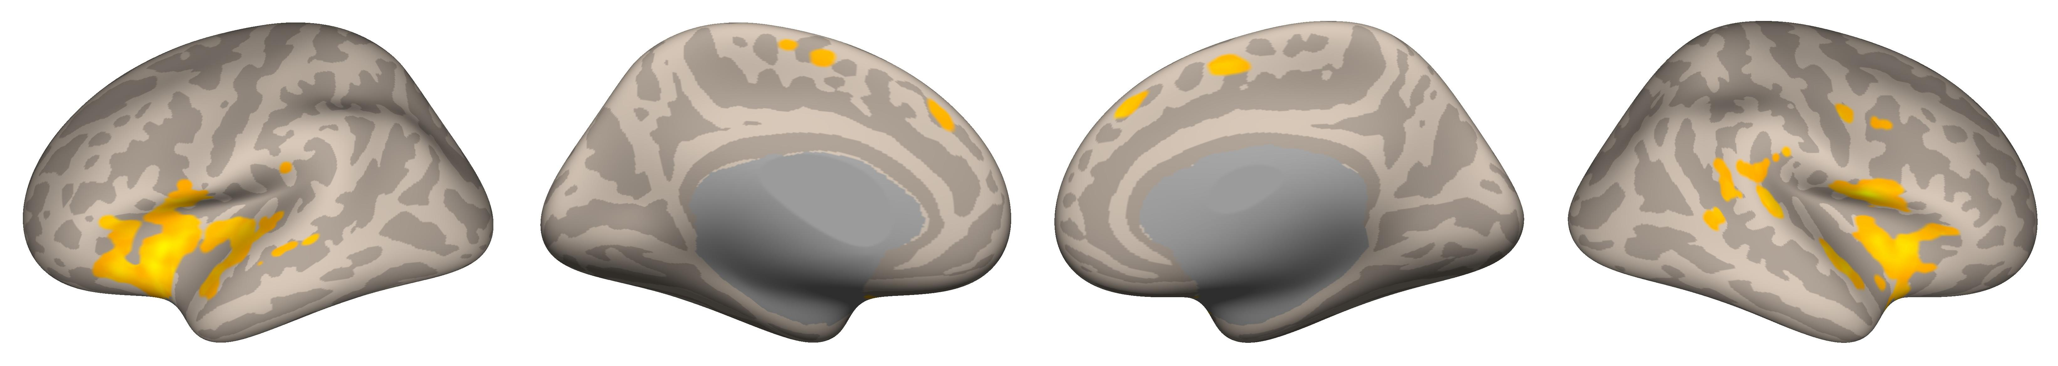
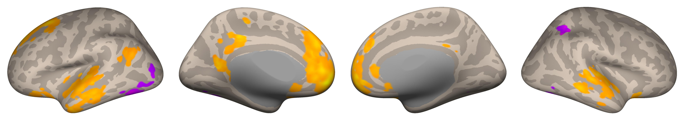


When You Heard it First: Age of Exposure Affects Functional Connectivity between Auditory and Reward Networks
Nicholas Kathios¹, Milena Aiello Quinci¹, Psyche Loui¹
¹Northeastern University
Background
fMRI Data Acquisition & Regions of Interest
Auditory Network Seed-Based Connectivity
Older adults tend to recall a disproportionately high number of autobiographical memories from their adolescence and young adulthood compared to any other time across the lifespan (the “reminiscence bump”)¹
This population recalls more autobiographical memories in response to music from this time and show lifelong preferences for this music:
Adolescents display relatively high sensitivity to reward, attributed to disproportionate maturation of subcortical limbic regions compared to frontocortical regions^{2,3}
Pleasurable music listening experiences involves similar circuitry, as the anterior insula facilitates interactions between the auditory and reward systems:^{5,6}
Taken together, increased preference for music from one’s adolescence might, in part, reflect increased responsivity to & connectivity of reward and auditory regions that persists across the lifespan
Hypothesis: Music first heard in listeners’ adolescence will show functional connectivity patterns that reflect this developmental trajectory
18 cognitively healthy older adults (ages 54-89; M=66.6)
10/18 participants completed a follow-up interview in which they reported when they thought they first heard familiar clips
Clips were categorized based on timing of exposure: childhood (0-11), adolescence (12-18), young adulthood (19-25), and adulthood (26-45) using self-reports & Song-Specific Age (SSA)
fMRI data were acquired using a Siemens Magnetom 3T MR. Continuous acquisition was used for 1440 volumes with a fast TR of 475 ms. Forty-eight axial slices were acquired as echo-planar imaging (EPI) functional volumes covering the whole brain (voxel size = 3 mm³).
Data were preprocessed and analyzed using SPM12 (Statistical Parametric Mapping) software⁷ and the CONN Toolbox⁸.
For seed to whole brain functional connectivity analyses, we seeded the mPFC as defined by the CONN toolbox, the anterior Insula⁹, and the Auditory Network⁶
For ROI-ROI connectivity analyses, we used Reward and Auditory Networks⁶ along with the mPFC & anterior Insula seed
Music encoded during adolescence differed in its functional connectivity patterns from that outside this time period, notably connecting the auditory network & mPFC to reward regions
These preferences may reflect improved reward learning in adolescence that persists across the lifespan
Adolescent sensitivity to social reward may also account for these preferences, consistent with the Music for Social Bonding hypothesis¹⁰
Future Directions: Cross-sectional & longitudinal music-listening fMRI studies; investigation of age-related differences on music reward-learning paradigms; SSA fMRI analyses in clinical populations
Rubin, D. C., & Schulkind, M. D. (1997). The distribution of autobiographical memories across the lifespan. Memory & Cognition, 25(6), 859–866. https://doi.org/10.3758/BF03211330
Casey, B. J., Getz, S., & Galvan, A. (2008). The adolescent brain. Developmental Review, 28(1), 62–77. https://doi.org/10.1016/j.dr.2007.08.003
Steinberg, L., Albert, D., Cauffman, E., Banich, M., Graham, S., & Woolard, J. (2008). Age differences in sensation seeking and impulsivity as indexed by behavior and self-report: Evidence for a dual systems model. Developmental Psychology, 44(6), 1764–1778. http://dx.doi.org/10.1037/a0012955
Casey, B., Galván, A., & Somerville, L. H. (2016). Beyond simple models of adolescence to an integrated circuit-based account: A commentary. Developmental Cognitive Neuroscience, 17, 128–130. https://doi.org/10.1016/j.dcn.2015.12.006
Belfi, A. M., & Loui, P. (2020). Musical anhedonia and rewards of music listening: Current advances and a proposed model. Annals of the New York Academy of Sciences, 1464(1), 99–114. https://doi.org/10.1111/nyas.14241
Wang, D., Belden, A., Hanser, S. B., Geddes, M. R., & Loui, P. (2020). Resting-State Connectivity of Auditory and Reward Systems in Alzheimer’s Disease and Mild Cognitive Impairment. Frontiers in Human Neuroscience, 14. https://www.frontiersin.org/article/10.3389/fnhum.2020.00280
Penny, W. D., Friston, K. J., Ashburner, J. T., Kiebel, S. J., & Nichols, T. E. (2011). Statistical Parametric Mapping: The Analysis of Functional Brain Images. Elsevier.
Whitfield-Gabrieli, S., & Nieto-Castanon, A. (2012). Conn: A Functional Connectivity Toolbox for Correlated and Anticorrelated Brain Networks. Brain Connectivity, 2(3), 125–141. https://doi.org/10.1089/brain.2012.0073
Deen, B., Pitskel, N. B., & Pelphrey, K. A. (2011). Three Systems of Insular Functional Connectivity Identified with Cluster Analysis. Cerebral Cortex, 21(7), 1498–1506. https://doi.org/10.1093/cercor/bhq186
Savage, P. E., Loui, P., Tarr, B., Schachner, A., Glowacki, L., Mithen, S., & Fitch, W. T. (2021). Music as a coevolved system for social bonding. Behavioral and Brain Sciences, 44. https://doi.org/10.1017/S0140525X20000333
We acknowledge support from Grammy Foundation, NSF-CAREER 1945436, NSF-STTR 2014870, and Kim and Glenn Campbell Foundation.
Childhood (0-11):
Adolescence (12-18):
Young Adulthood (19-25):
Univariate Main Effect of Age of Exposure
Voxel Threshold: p FDR-corrected <0.05; Cluster Threshold: p FDR-corrected <0.05
Music from adulthood (26-45) did not survive corrections
ROI-ROI Connectivity
Adolescence (12-18):
Young Adulthood (19-25):
Voxel Threshold: p FDR-corrected <0.05; Cluster Threshold: p FDR-corrected <0.05
Music from childhood (0-11) and adulthood (26-45) did not survive corrections
Anterior Insula Seed-Based Connectivity
Childhood (0-11):
Discussion
Methods
Adolescence (12-18):
Childhood
Adolescence
Voxel Threshold: p-FDR corrected <0.05; Cluster Threshold: p FDR-corrected <0.05
Music from young adulthood (19-25) and adulthood (26-45) did not survive corrections
mPFC Seed-Based Connectivity
References
Adolescence (12-18):
Voxel Threshold: p FDR-corrected <0.05; Cluster Threshold: p FDR-corrected <0.05
Music from childhood (0-11), young adulthood (19-26), and adulthood (26-45) did not survive corrections
Notes:
This poster was inspired by the “reminiscence bump” effect, or the tendency of older adults to be able to recall a disproportionately high amount of autobiographical memories from their adolescence & young adulthood compared to any other time across the lifespan.
In fact, neurodevelopment in adolescence seems to support this suggestion, as adolescence is a time in which individuals are highly sensitive to rewards. This sensitivity has been attributed to the rapid maturation of subcortical reward regions during this time, and circuit-based models suggest that regulatory mPFC connections to the reward system develop throughout adolescence.
Importantly, these regions & connections are quite important in pleasurable music experiences, which involve interactions between the auditory system + reward regions, facilitated by the anterior insula

